Slide 1

American Samoa Community College
Department: Name
ASCC 2022-2024 Catalog Review
Presentation Date (January 30, 2024)
Notes:
79 Slides

Slide 2
Program Purpose
What is the Purpose of the Program?
  Mission
Insert Program/Degree Mission Statement
Notes:
Note:
Close the loop: Faculty discuss assessment results, reach conclusions about their meaning, determine implications for change, and implement them. (Allen, M.J

Slide 3
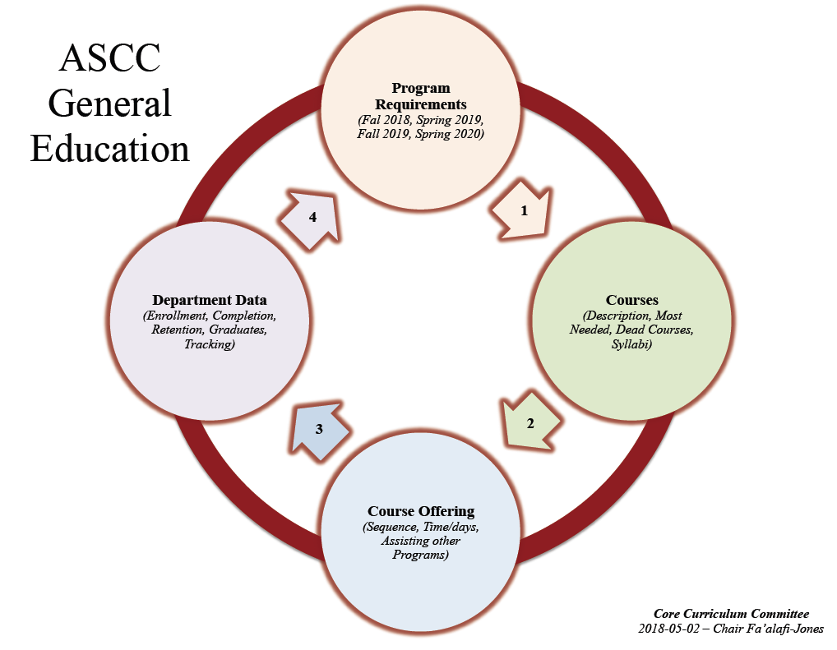
Review Structure
Fall 2022-Spring 2023
Fall 2023- Spring 2024
Notes:
Note:
No need to edit this slide unless the structure of your program is different than the one you see here.

Slide 4
Program Aims
What are the goals of the Program?
It is the primary aim of the program that all students upon completion of their degree requirements will have attained a significant amount of knowledge, understanding and confidence in their abilities about the following concepts or qualities: responsibility, critical thinking, problem solving, creativity, self motivation, interdependence, believer in life long learning, managing personal finances and being good communicators.
With the above, they can be productive and efficient players in the drive to Food Security besides being good stewards of Natural Resources and the Environment.
Provide quality education
Prepare students for off-island transfer
Prepare students for employment on-island
Program Focus
Notes:
Note:
Program Aims/Goals: are long range statements. They describe the knowledge, skills, and values expected of graduates and it should be consistent with the mission of the college and the mission of the program.

Slide 5
Sample Program Aims
Provide quality education
Prepare students for off-island transfer to 4-year colleges/universities
Prepare students to enter the local workforce – employment on-island

Slide 6
Program Curriculum Qualities
What are the Qualities of the Program?
PLOs 1-4 refer to next slide
1
Purpose
Program Aims
4
2
3

Slide 7
Program Curriculum Qualities
Program Learning Outcomes:
PLO 1: Demonstrate an understanding of the different career opportunities in Agriculture, Community and Natural Resources.
PLO 2: Understand the importance of Agriculture, Community and Natural Resources to the Samoan culture and the environment of American Samoa.
PLO 3: Apply the concepts and principles of science and technology needed for work in the field of Agriculture, Community and Natural Resources.
PLO 4: Utilize knowledge based in Agriculture, Community and Natural Resources to adapt to social and economic changes and challenges.
INSERT PROGRAM LEARNING OUTCOMES

Slide 8
Program Competencies
What are the competencies (CLOs) for each program quality (PLO or GEO)?
PLO/GEO 1: Demonstrate an understanding of the different career opportunities in Agriculture, Community and Natural Resources.
Refer to Program Alignment Matrix
PLO/GEO 1
CLO 1
Describe the career opportunities available in agriculture, community & natural resources.
CLO 2
Create models of intensive and extensive livestock systems to deal with existing environmental problems.
PLO 2/ GEO 1
PLO 2: Understand the importance of Agriculture, Community and Natural Resources to the Samoan culture and the environment of American Samoa.
CLO 1
Compare and contrast the cultural uses of the natural resources of American Samoa and any other Pacific country.
CLO 2
Articulate an appreciation of agriculture, natural resources, agribusiness, and family and consumer science while working under the supervision of agriculture professionals.

Slide 9
Program Competencies
What are the competencies (CLOs) for each program quality(PLO or GEO)?
PLO/
GEO 3
Apply the concepts and principles of science and technology needed for work in the field of Agriculture, Community and Natural Resources.
CLO 1
Create models of intensive and extensive livestock systems to deal with existing environmental problems.
CLO 2
The importance of genetics in horticultural plant improvement.
PLO/
GEO 4
Utilize knowledge based in Agriculture, Community and Natural Resources to adapt to social and economic changes and challenges.
CLO 1
Apply the acquired knowledge in teaching clients in the community or hospital
CLO 2
Demonstrate understanding of agricultural production, marketing, pricing, income and decision making involving farm operations

Slide 10
Competencies Mapped in Courses
General Education Courses:
  1st Year Gen Ed courses: List Program Gen. Ed. Courses
  2nd Year Gen Ed courses: List Program Gen. Ed. Courses
Program Requirement Courses: (*)
  Certificate/Degree: AGR 100-I, AGR 100-II, AGR 152, AGR 250, NUT 150, FAM 250, FAM 260, ANS 150A, ANS 150B, NRS 180, AGR 197, NRS 200, NRS 250
Elective Credits: (*)
Courses: List Program Electives

Slide 11
Cycle of Data Review
Academic Year 2022-2024 and Fall 2022
  Enrollment:
Enrollment Statistics by courses offered: | Fall 2022 |  | Spring 2023 | Fall 2023 | Spring 2022 | Spring 2024
General Education 1st Year: | AGR 152 (8) |  | AGE 150 (9) | AGR 152 (5) |  | AGE 150 (5)
Program Optional Courses 2nd Year: | AGR 100-I (3) |  | AGR 100-II (7) AGR 250 (3) | AGR 100-I (5) |  | AGR 100-II (2) AGR 250 (3)
Certificate Courses | N/A |  | N/A | N/A |  | N/A
Degree Courses | AGR 197 (2) ANS 150A (2) ANS 150B (3) | NRS 180/L (3) NRS 250 (6) NUT 150 (24) | ANS 150B (1) NUT 150 (27) NRS 200/L (2) | ANS 150A (8) | NUT 150 (23) NRS 250 (2) | ANS A (1) ANS B (3) NUT 150 (24)
Content Enrichment Courses | N/A |  | N/A | N/A |  | N/A

Slide 12
Review of Program Data
Academic Year 2022-2023 and Fall 2022:
  Courses Offered:
Enrollment Statistics by courses offered: | Fall 2022 |  | Spring 2023 | Fall 2023 | Spring 2022 | Spring 2024
General Education 1st Year: | AGR 152 |  | AGE 150 | AGR 152 |  | AGE 150
Program Optional Courses 2nd Year: | AGR 100-I |  | AGR 100-II AGR 250 | AGR 100-I |  | AGR 100-II AGR 250
Certificate Courses | N/A |  | N/A | N/A |  | N/A
Degree Courses | AGR 197 ANS 150A ANS 150B | NRS 180/L NRS 250 NUT 150 | NUT 150 ANS 150B | ANS 150A | NRS 180 NUT 150 | ANS 150A ANS 150B NUT 150
Content Enrichment Courses | N/A |  | N/A | N/A |  | N/A

Slide 13
Cycle of Data Review
Academic Year 2022-2024 and Fall 2022:
  Low Enrollment:
Enrollment Statistics by courses offered: | Fall 2022 | Spring 2023 | Fall 2023 | Spring 2024
General Education 1st Year: | # | # |  | #
Program Optional Courses 2nd Year: | # | # |  | #
Certificate Courses | # | # |  | #
Degree Courses | # | # |  | #
Content Enrichment Courses | # | # |  | #

Slide 14
Cycle of Data Review
Academic Year 2022-2024 and Fall 2022:
  Courses Cancelled:
Enrollment Statistics by courses offered: | Fall 2022 | Spring 2023 | Fall 2023 | Spring 2024
General Education 1st Year: | # | # | #
Program Optional Courses 2nd Year: | # | # | #
Certificate Courses | # | # | #
Degree Courses | # | ANS 150A | ANS 150B NRS 250 | NRS 200/L
Content Enrichment Courses | # | # | #

Slide 15
Cycle of Data Review
Academic Year 2022-2024 and Fall 2022:
  Certificates and Degrees Conferred:
Enrollment Statistics by courses offered: | Fall 2022 | Spring 2023 | Fall 2023 | Spring 2024
Certificate Courses | N/A | N/A | N/A
Degree Courses | AS in General Agriculture (1) AS in Natural Resources (5) | AS in General Agriculture (3) | AS in General Agriculture (1) AS in Natural Resources (2)

Slide 16
Cycle of Data Review
Academic Year 2022-2024 and Fall 2022:
  Number of transfer students:
Enrollment Statistics by courses offered: | Fall 2022 | Spring 2023 | Fall 2023 | Spring 2024
Certificate Courses | N/A | N/A | N/A
Degree Courses | AS in General Agriculture (1) AS Natural Resources (3) | AS in General Agriculture (2) | AS in General Agriculture (1) AS in Natural Resources (2)

Slide 17
Cycle of Data Review
Academic Year 2022-2024 and Fall 2022:
  Number of students that transition into the Workforce:
Enrollment Statistics by courses offered: | Fall 2022 | Spring 2023 | Fall 2023 | Spring 2024
Certificate Courses | # | # | #
Degree Courses | # | # | #

Slide 18
Cycle of Data Review
Academic Year 2022-2023 and 2023-2024:
  Insert Pedagogy/Methods of Teaching:
    Lectures
    Laboratory class and activities
    Etc…

Slide 19
Building Bridges
Academic Year 2022-2023 and 2023-2024:
  Local MOUs
    MOU 2022-2023(3)
    MOU 2023-2024 (2)
    MOU 2024-2025 (Receive Aug 2024)
  Grants (*)
  USDA NIFA Caripac RIIA-(Scholarships for Students Off-island and On-island).
  Outcomes:
  Increase the number of students majoring and graduating in the Agriculture Community and Natural Resources fields.
  Enhance and strengthens our instruction program.
  - Articulations
    External Articulation of Courses
      Samoa Government Internship- MAF, SROS
      OTS REU Costa Rica LSAMP
      EcoREU 2023 Cohort, University of Arkansas
      Haskell Environmental Research Studies Institute 2022, Kansas University
    Internal/External Articulation of Gainful Employment
      ACNR Local Internship Programs
      LSAMP (Louis Stokes Alliance for Minority Participation)
      ACNR Forestry Scale Restoration Project (LSR)
      Education Extension Site Visit to Manu’a Island.
Notes:
Grants:
% of Grants Obtained
% of outcomes assessed that are funded by grants
MOU/ MOA: Memorandum of Understanding (MOU) obtained
% of programs MOU (Aggregated)
% of students per program involved and assessed (Disaggregated)
Memorandum of Agreement (MOA) obtained
% of programs MOA (Aggregated)
% of students per program involved and assessed (Disaggregated)

Slide 20
Advisory Council:
Insert Advisory Council for Program/Department

Slide 21
Personnel and Credentials:
Insert Instructors/ Personnel and Credentials

